Slide 1
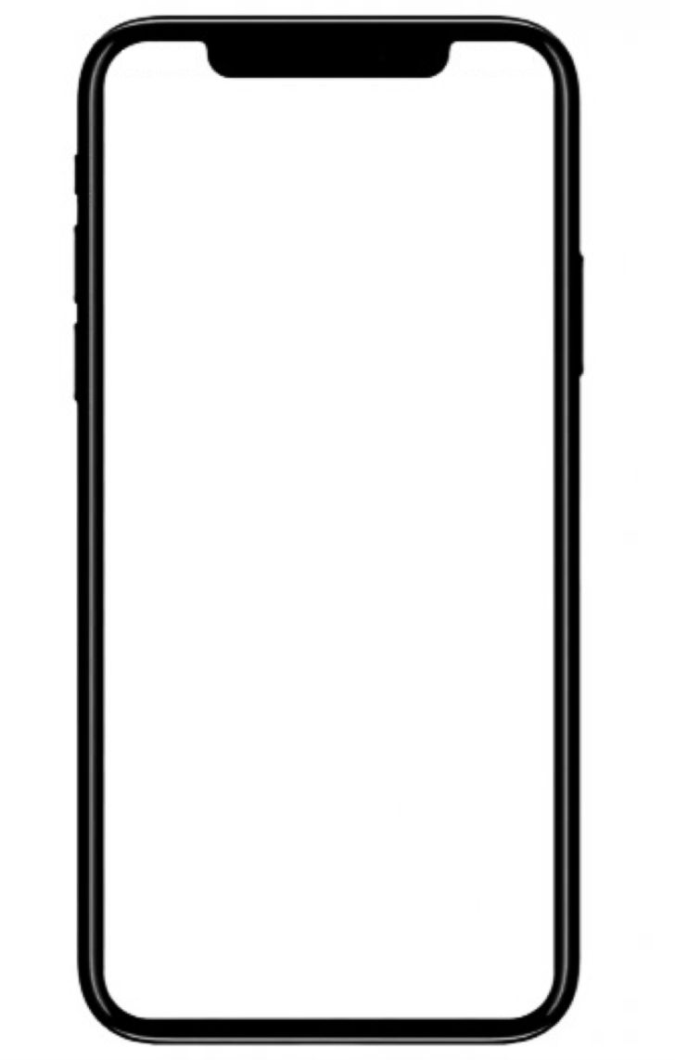
Doodle
Software Engineering
Term Project
201735806 권수환
201332086 이석재
201533661 이승수

Slide 2

Doodle
Project Object
What we made : Cooperating tool for elaborating Ideas with other people.
Program Type : Android application
Due date : 2019 May 30
Tool : Android Studio, eclipse, starUML
Core Function
1. Sketch & Text Relaying Tools
Requirement: should be drawn on point smoothly
2. Networking
Requirement: display real-time sketch board

Slide 3
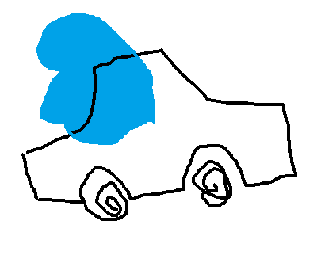
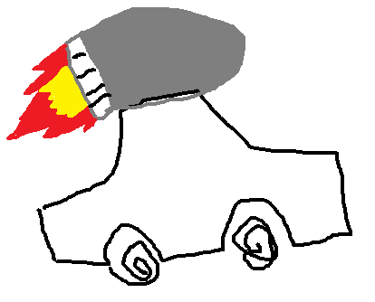
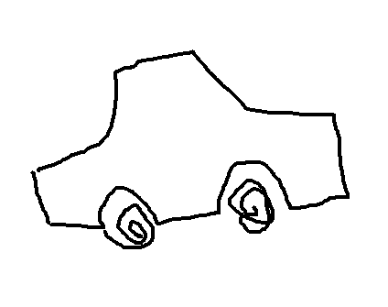


Doodle
Project Object
Core function 1- Sketch & Text Relaying Tools
Application for developing initiated Ideas to be more better and helpful.
<Idea Initiator>
<USER 1>
<USER 2>
I want to invent some vehicle!
I want to invent vehicle which can go fast. It’s name is car.
It will be better if it can fly.
So I will add rocket.
I want to invent vehicle which can go fast. It’s name is car.
It will be better if it can fly.
I want to invent vehicle which can go fast. It’s name is car.
<Idea Initiator>
<USER 3>
<USER 4>

Slide 4
Doodle
Project Object
Core function 1- Sketch & Text Relaying Tools
Application for developing initiated Ideas to be more better and helpful.
Sketch function or Text Relaying function required developing Ideas
Bulletin board: exhibiting good ideas to many users.
Sketch module: at Sketch room, people can develop their ideas with relaying sketch.
Texting module: at Texting room, people can relaying their written ideas.

Slide 5
Doodle
Project Object
Core function 2-Networking
Connecting users and Sketch & Text data
Server-Client system and Database needed to login, relaying ideas
Login Process: to user certification and inter-user communication
Server-Client system: make socket communication between Users and Server.
Database: to store user informations, idea room datas, and sketch and text datas.

Slide 6
Doodle
Progress Plan
Requirements
Following requirement engineering process, Consider user & system requirement
→ Interviewing with senior students who took ‘mobile programming class’
*need to be smooth writing, network reliability
System modeling
Choose 1 or 2 system model, consider system perspective & using UML diagram
Architectural design
Application type: Transaction processing application
Architecture Pattern: Server-Client Pattern
Design and implementation
Design application flow & Implementation, Integration of modules and functions
Software testing
Alpha-testing(Subsystem, System), Beta-testing(Acceptance(User) Test)

Slide 7
Doodle
Assignment for team Members
<Together>
Requirements
System Modeling
<For Each Members>
권수환
Architectural design
Design and implementation : Database, Server programming, connection
이석재
Software testing : Test planning & feedback
이승수 Architectural design
Design and implementation : Login, Sketch function, UI/UX, code modification

Slide 8
Doodle
Schedule
Week 0
April 28 ~ April 30
Interview, Proposal
Requirement Discovery & Specification
Week 1
May 1 ~ May 7
Design Components & Networking Protocols
System Modeling & Architectural Design
Week 2
May 8 ~ May 14
Implement Views & Struct Database, Server function
Software Design & Implementation
Week 3
May 15 ~ May 21
Integration & Check Network Connection
Component Integration, Testing
Week 4
May 22 ~ May 29
Release & Feedback, Application Improvement
Software Validation & Evolution

Slide 9
Thank you!

